Slide 1


Global Superstore – Power BI Dashboard
An interactive dashboard providing actionable insights into global sales performance, profitability, and customer behavior.
by Rohit Prakash

Slide 2
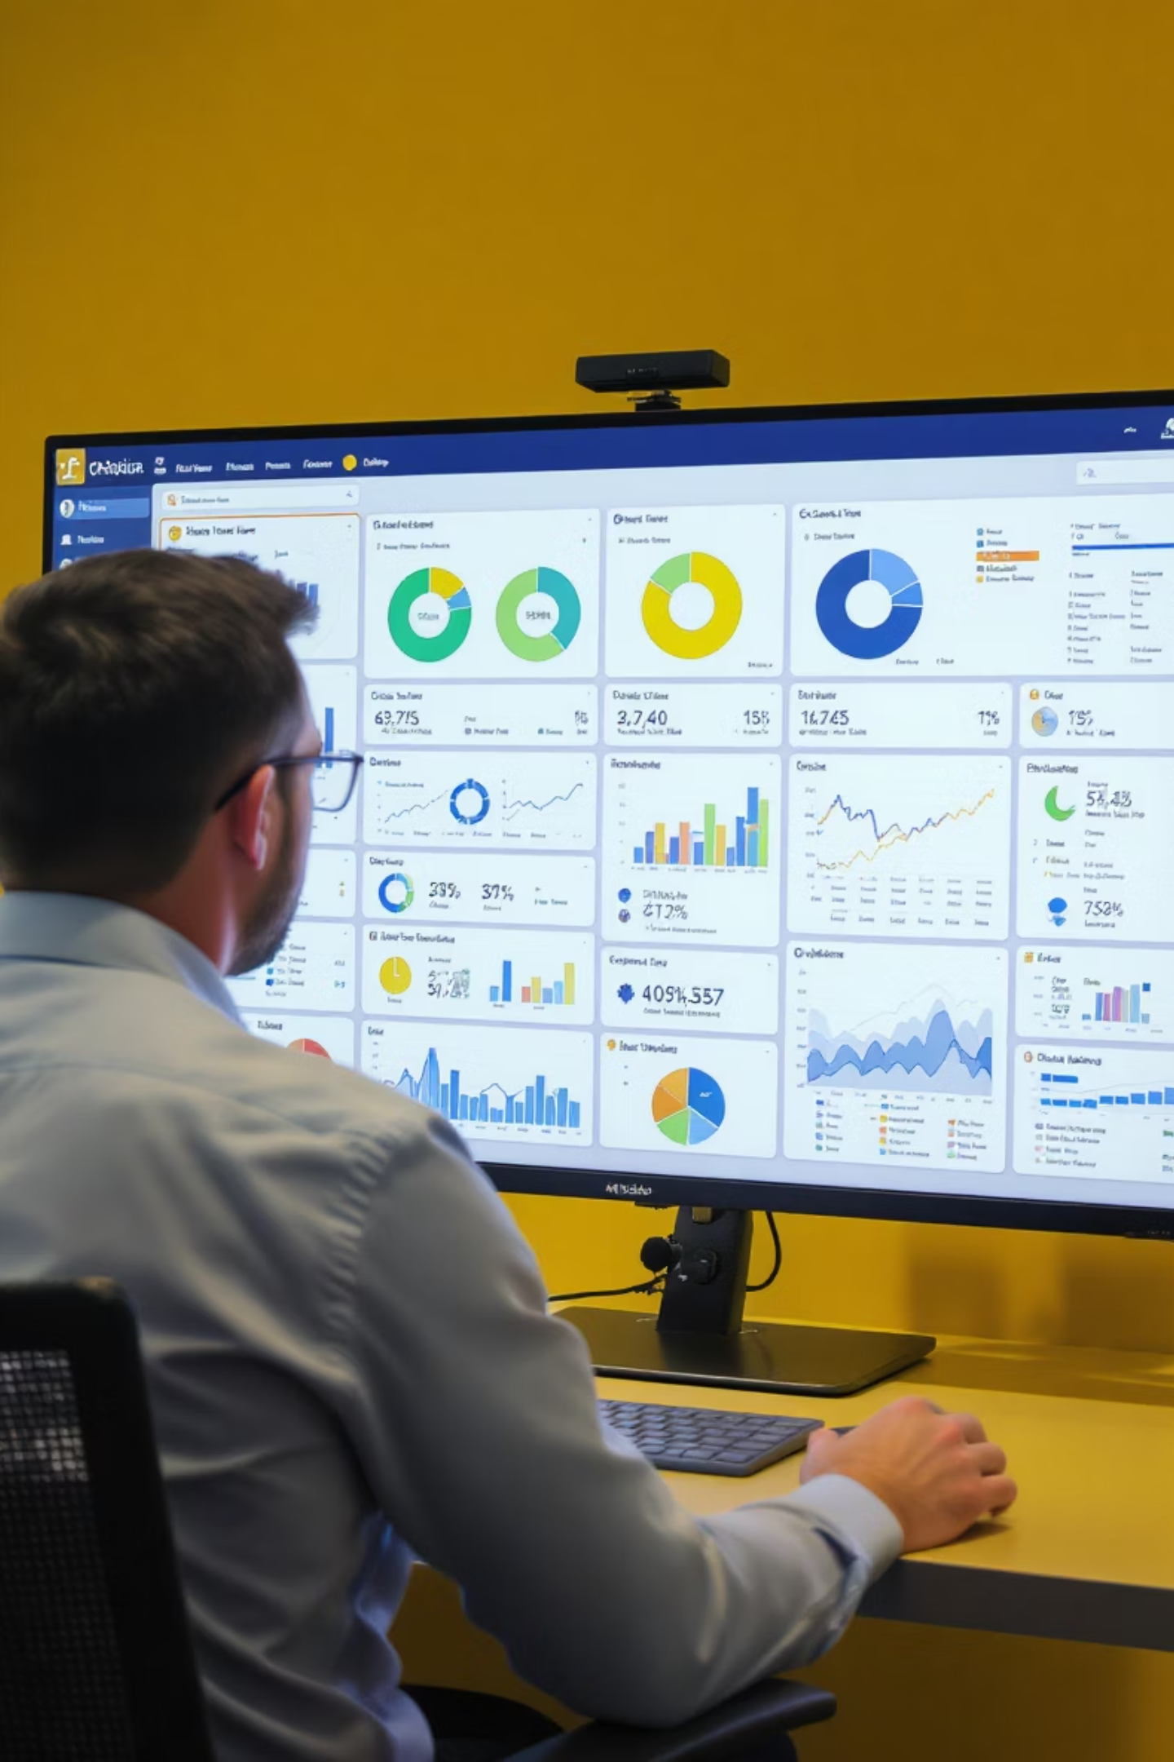
Project Overview
1
Revenue Growth
Identify under-penetrated regions and product lines with high growth potential.
2
Margin Improvement
Analyze discount impact on profitability and recommend optimal thresholds.
3
Operational Efficiency
Benchmark delivery performance to balance shipping cost vs. customer satisfaction.
4
Customer Profiling
Discover high-value customer segments among Consumer, Corporate, and Home Office.

Slide 3





Key Research Questions
Performance
Which regions and product sub-categories are over/under-performing?
Discounting
What discount level maximizes volume without eroding margins?
Shipping
Is expedited shipping cost-effective for repeat business?
Seasonality
How do seasonal trends help with inventory planning?

Slide 4
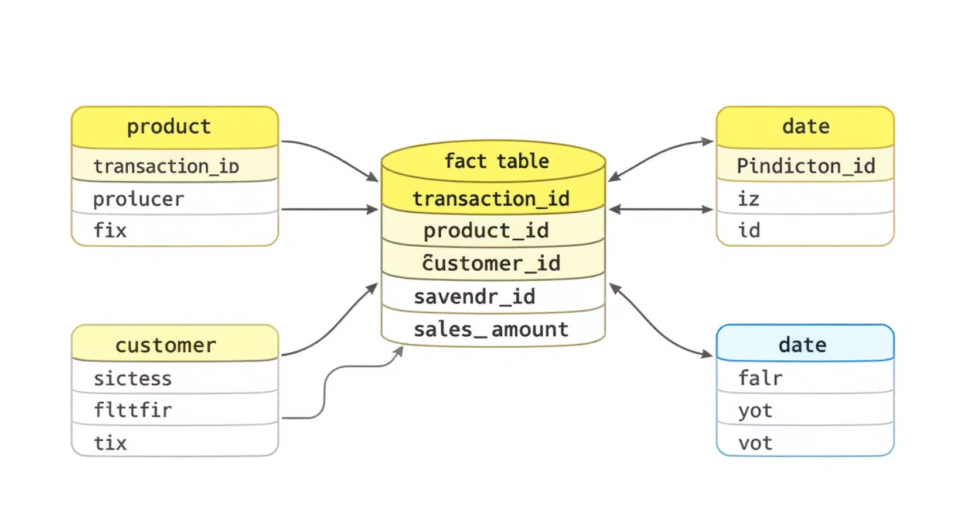
Data Model
Star Schema Structure
Built with relationships established via surrogate keys.
Fact Table: Sales Orders
Dimension Tables: Calendar, Product, Customer
Additional Dimensions: Employee, Territories, Returns

Slide 5
Power BI Visualizations
Page
Visual Type
Description
Dashboard
KPI Cards, Trend Lines, Heatmap
Overview of Sales & Profit by Region
Category Analysis
Drill-down Bar Chart
Category → Sub-category comparison
Discount Impact
Scatter Plot
Discount % vs. Profit Margin %
Logistics
Box & Whisker Plot
Lead Time by Region and Ship Mode
Map View
Filled Map
Profit Margin % by Country/City

Slide 6






DAX Measures Used
Discount Analysis
Average Discount
Discount to Profit Correlation
Financial Metrics
Total Sales
Total Profit
Growth & Time
Profit Margin (%)
YoY Sales Growth
YoY Profit Growth
Average Order Lead Time

Slide 7

Success Criteria
1
Interactive Visuals
All visuals are fully interactive with filter-sync enabled.
2
Optimized Performance
Report loads in less than 5 seconds.
3
Actionable Insights
Provides at least three non-obvious, data-driven insights.

Slide 8
Project Files
Data Files
Documentation
Calendar.xlsx
Problem_Statement_v1.pdf
Customer Details.xlsx
Firstname_Lastname_CPDA_Bx.pbix
Employee.xlsx
Power BI dashboard (replace with your name & batch)
Product Details.xlsx
Returns.xlsx
Sales.xlsx
Territories.xlsx

Slide 9




Insights & Recommendations
APAC Region
Strong sales growth but low profit margins. Optimize discounts.
Office Supplies in EMEA
High return rates. Consider reviewing quality/expectations.
Home Office Customers
Highest average profit per order. Tailor retention offers.

